Slide 1
Customer Churn Forecasting and Analysis for ConnectTel
Predicting and Analyzing Customer Retention Using Machine Learning

Slide 2
Project Overview
The objective of the model is to develop a predictive system that accurately forecasts customer churn for ConnectTel, enabling the company to proactively identify customers at high risk of leaving. By leveraging machine learning and advanced analytics, the model aims to provide actionable insights that ConnectTel can use to implement targeted retention strategies. This will help reduce customer attrition, enhance customer loyalty, and strengthen ConnectTel’s position in the competitive telecommunications market.

Slide 3
Data Overview
Dataset Summary: The dataset has 7043 records and 21 features.
It has 1 feature that is float64, 2 that are int64, and 18 that are object datatypes. The dataset has no non-null value.
Data Preprocessing: One-hot encoding using ‘get_dummies’ was employed to convert nominal categorical features into numerical ones. Duplicate features of 'No internet service‘ was dropped. The target variable was encoded using ‘Label Encoder’. ‘MinMax scaler’ was used to normalize the features where necessary.

Slide 4
Methodology
Data Analysis: Univariate and Bivariate analysis was used to analyse the data.
Machine Learning Algorithms: 6 machine learning algorithms were tried for this modelling.
Evaluation Metrics: The recall and F1-score were considered most important, with recall being especially critical if ConnectTel aims to minimize false negatives (i.e., customers who are at risk of churning but are incorrectly predicted to stay).

Slide 5
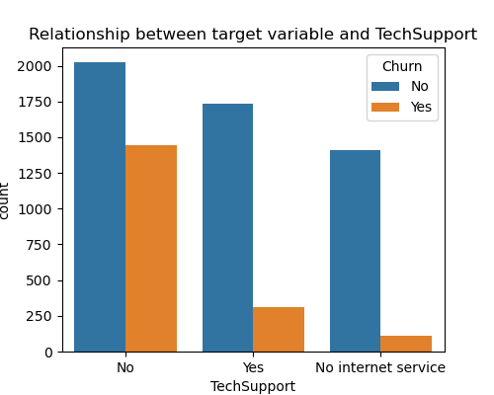
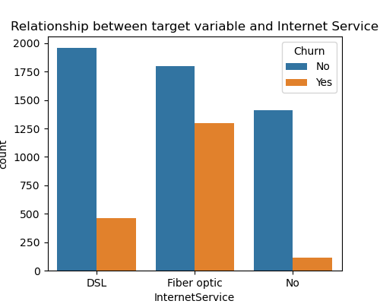
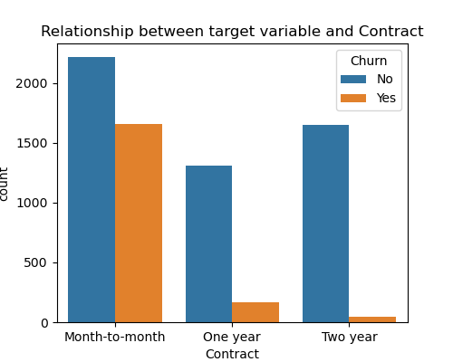
Analysis Insights
Churn Vs Tech Support
Customers with tech support have a lower churn rate. Over 70% of customers that left are without tech support.
Churn Vs Internet Service
Customers without internet service have the lowest churn rate followed by DSL
Churn Vs Contract type
Customers on month-to-month contracts have a higher churn rate than customers on extended contracts. This makes up over 80% of customers that churned.

Slide 6
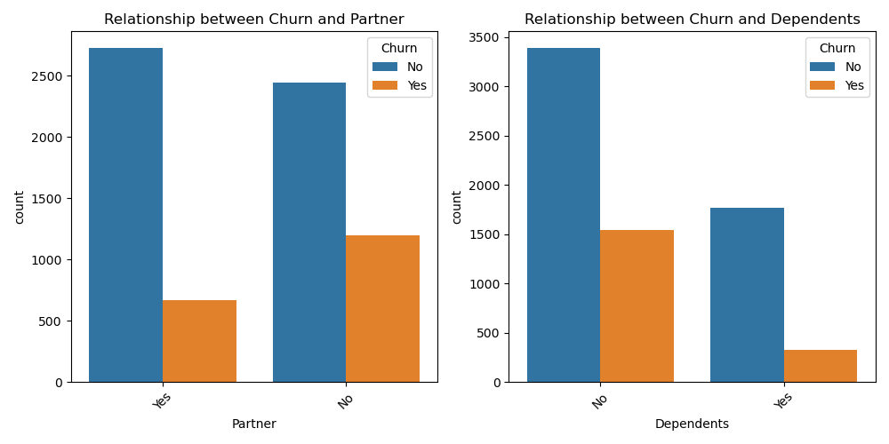
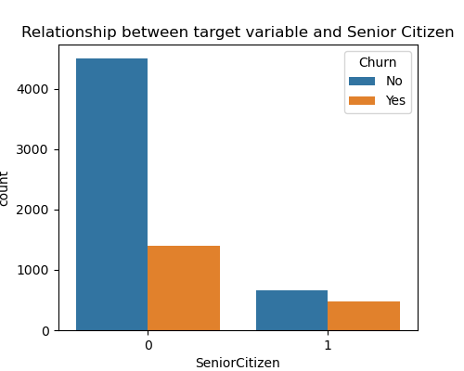
Analysis Insights
Churn Vs Partner
Customers with partners did not churn as much as those without partners.
Churn Vs Dependents
Customers with dependents did not churn as much as those without dependents
Churn Vs Senior Citizen
Senior citizens have over 70% churn rate.

Slide 7
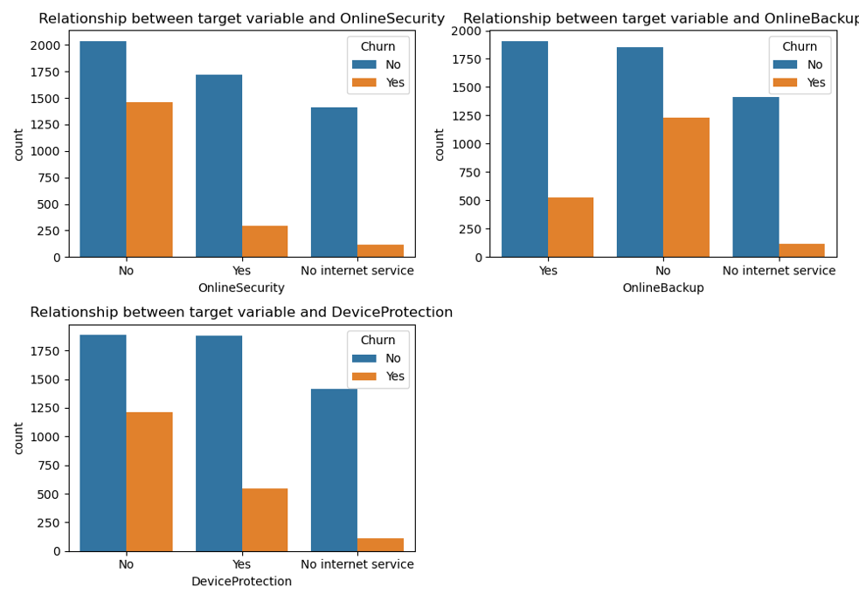
Analysis Insights
Relationship between Churn
And Online Security
And Online Backup
And Device protection
A notable trend emerges: customers who utilize value-added services demonstrate a significantly reduced churn rate, with a decrease of over 60% compared to those who do not.

Slide 8
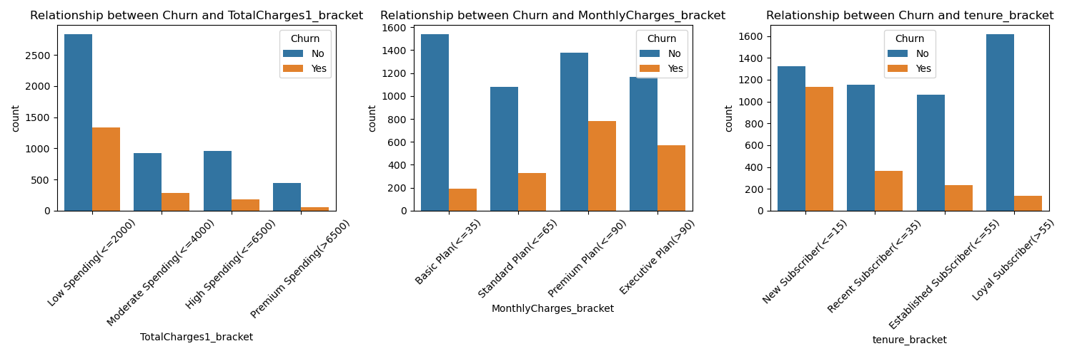
Analysis Insights
Churn Vs Total Charges
Customers with low total charges tend to leave the company services
Churn Vs Monthly Charges
Customers with higher monthly charges exhibit a significantly higher churn rate, exceeding 70%.
Churn Vs Tenure
New subscribers have a higher churn rate than customers that have been with the company for a long time

Slide 9
Actionable Recommendations
ConnectTel needs to improve their internet service especially Fibre Optics
Tailor services or communication strategies for senior citizens to reduce churn within this demographic
The company should focus retention strategies on customers without family-related ties who might be at higher churn risk.
Promote these value-added services to reduce churn among high-risk customers.
Promote/extend tech support experiences to retain customers who face technical issues.
Promote longer contracts among customers may be by providing loyalty discounts.
Consider loyalty programs or retention strategies for new subscribers to retain them.
Consider a more competitive pricing or flexible package for customers with high monthly bills.

Slide 10
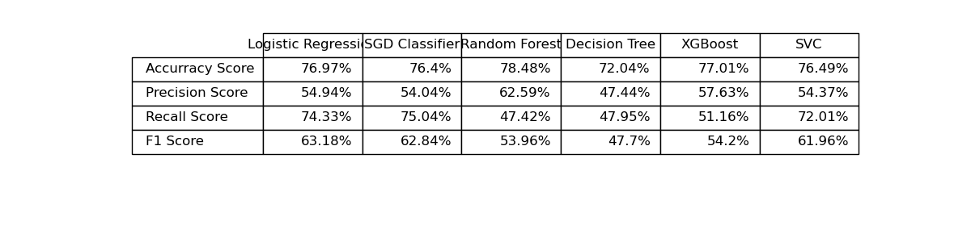
Model Performance
Based on the results table, Logistic Regression, SGD Classifier, and SVC exhibit the highest Recall and F1-score metrics, making them strong contenders for our model.

Slide 11
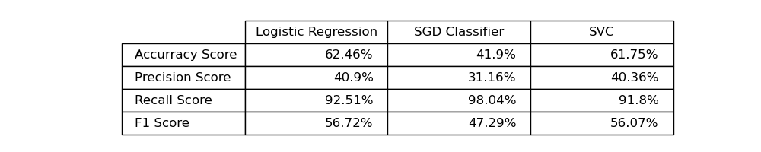
Model Performance After Hyper Parameter Tuning
Upon analyzing the results, we observe that SGD Classifier achieves the highest Recall score. However, considering the overall performance, including Precision, F1-score, and Accuracy, Logistic Regression offers a more robust and balanced solution. Therefore, we recommend Logistic Regression as the optimal model for ConnectTel.

Slide 12
Conclusion & Next Steps
Summary: Based on our analysis, Logistic Regression is the recommended model for predicting customer churn. To mitigate churn, we advise implementing loyalty programs, offering targeted discounts, promoting value-added services, and extending technical support.
Future Work: To further enhance the model, we recommend exploring a larger dataset with a more balanced churn ratio. Additionally, experimenting with alternative machine learning algorithms could potentially yield improved predictive performance.

